Slide 1

Drug Labels using Deep Learning with PaddleOCR

Slide 2
OCR Applications
Office Automation Systems
Factory Automations
Online Education
Map Productions
Document Electronation
Identity Authentication
Vehicle License Plate Recognition
Factory Products
Student’s offline homework/test paper

Slide 3
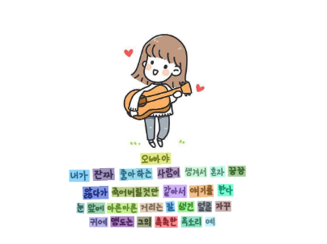

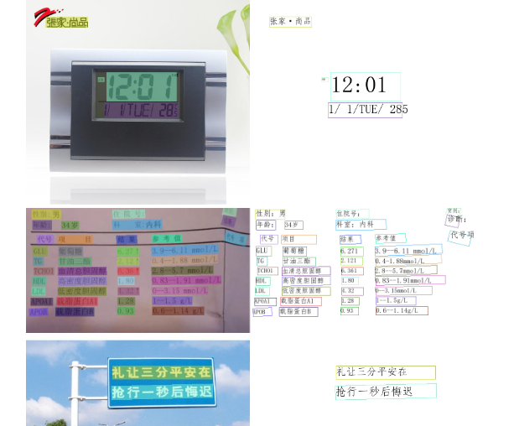
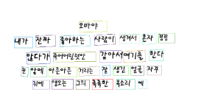
Results From Paper

Slide 4
Abstract
Ultra lightweight OCR System (PP-OCR)
Model Size:
3.5M for Chinese Characters (6622)
2.8M for Alphanumeric Symbols (63)
Pretrained Model for Chinese & English:
Text Detector (97K images)
Direction Classifier (600K images)
Text Recognizer (17.9M images)
Also supported for French, Korean, Japanese & German

Slide 5
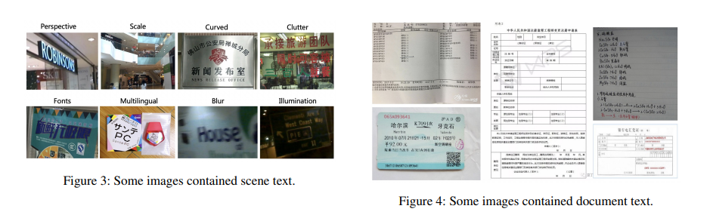
Types of Text
Notes:
Document Text Problems: high density and long text need to be solved. Otherwise, document image text recognition often comes with the need to structure the results, which introduced a new hard task.
Computational Efficiency In practical, the images that need to be processed are usually massive. CPU is preferred to be used than GPU

Slide 6
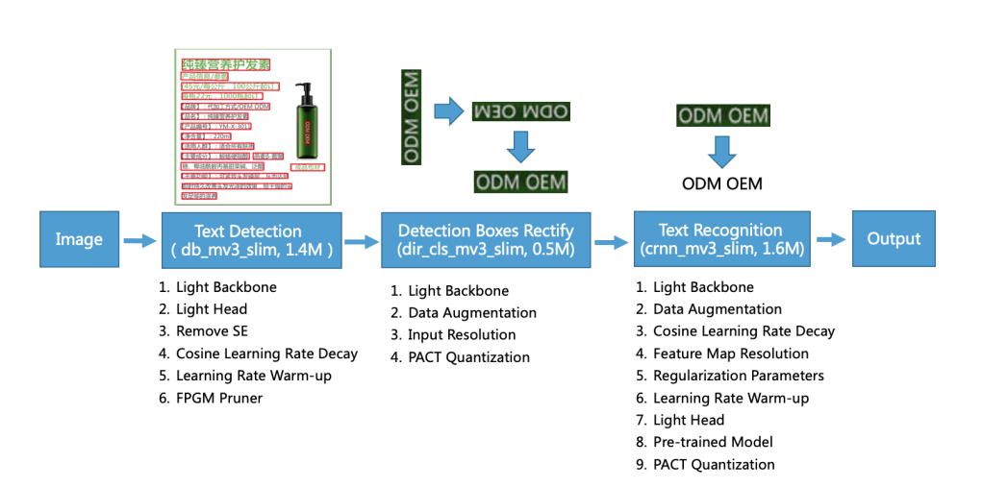
Framework
Notes:
For alphanumeric symbols recognition, the model size of text recognition is from 1.6M to 0.9M. The rest of the models are the same size.

Slide 7

Text Detection
is to locate the text area in the image
we use Differentiable Binarization (DB) (Simple segmentation network)

Slide 8
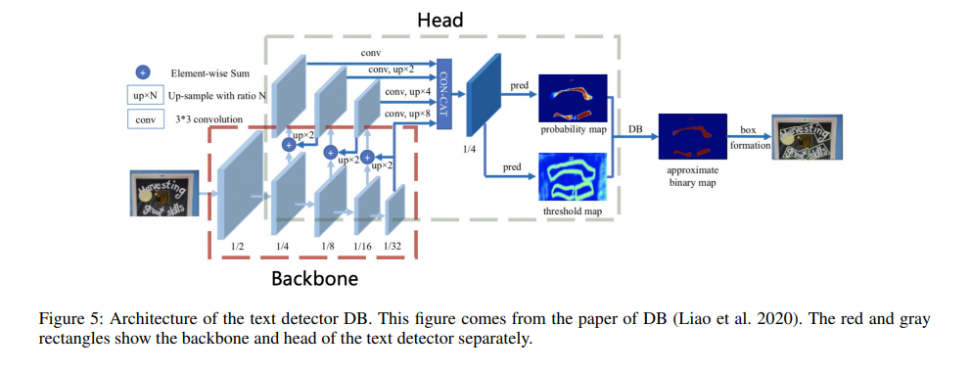
Text Detection Architecture DB

Slide 9
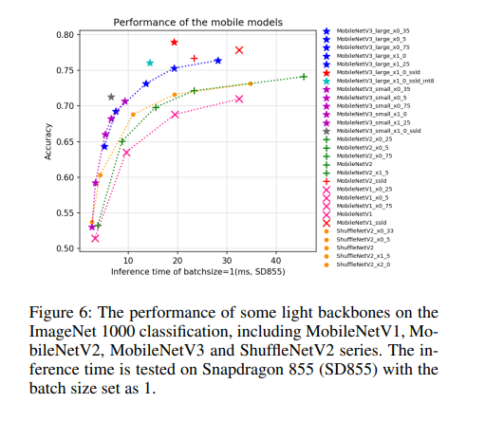
Light Backbone
The size of backbone has dominant effect on the model size of a text detector
MobileNetV1, MobileNetV2, MobileNetV3 ShuffleNetV2
MobileNetV3 large x0.5 to balance accuracy and efficiency empirically

Slide 10
Light Head
The head of the text detector is similar as the FPN (Lin et al. 2017) (next slide) architecture in
object detection
fuse the feature maps
different scales to improve the effect for the small text regions detection. For
1 × 1 convolution is often used to reduce the feature maps to the same number of channel
The probability map and the threshold map are generated from the fused feature map with convolutions which are also associated with the above inner channels (refer to main diagram)
inner channels is reduced from 256 to 96, the model size is reduced from 7M to 4.1M, but the accuracy declines slightly.

Slide 11
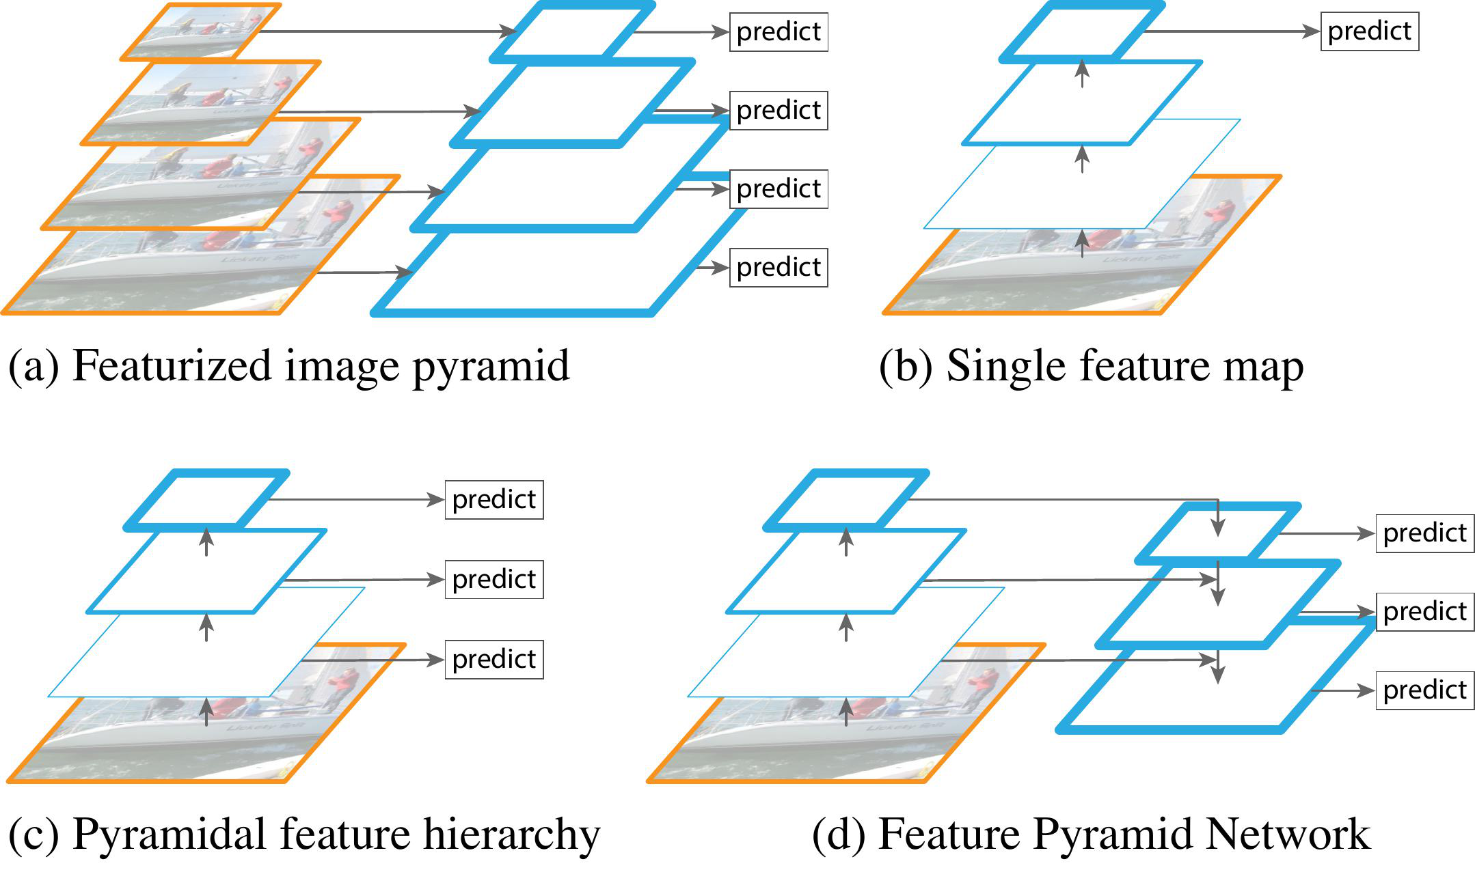
FPN – Feature Pyramid Network

Slide 12
Remove SE (Squeeze & Excitation)
model inter-dependencies between channels explicitly and re-calibrate channel-wise feature responses adaptively
SE blocks can improve the accuracy of the vision tasks
the search space of MobileNetV3 contains them and numerous of SE blocks are in MobileNetV3

Slide 13
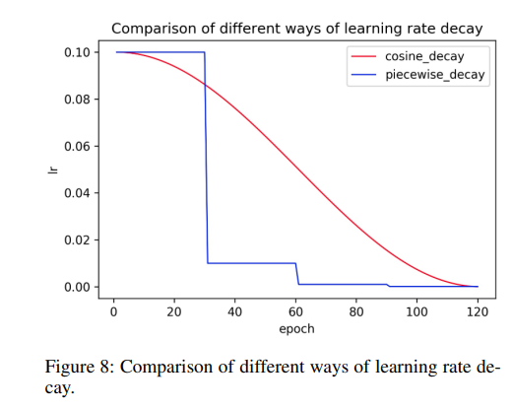
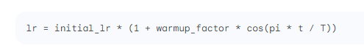
Cosine Learning Rate Decay
The lower the learning rate, the slower the change of the loss value
In the early stage of training, the weights are in random initialization state, so we can set a relatively large learning rate for faster convergence
late stage of training, the weights are close to the optimal values, so a relatively smaller learning rate should be used

Slide 14
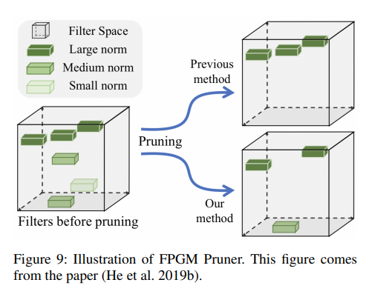
FPGM Pruner
In order to avoid the model performance degradation caused by the model pruning, we use FPGM to find the unimportant
Uses geometric median as the criterion and the each filter in a convolution layer is considered as a point in Euclidean sub-network in original models
Then calculate the geometric median of these points and remove the filters with the similar values, as shown in Figure 9

Slide 15
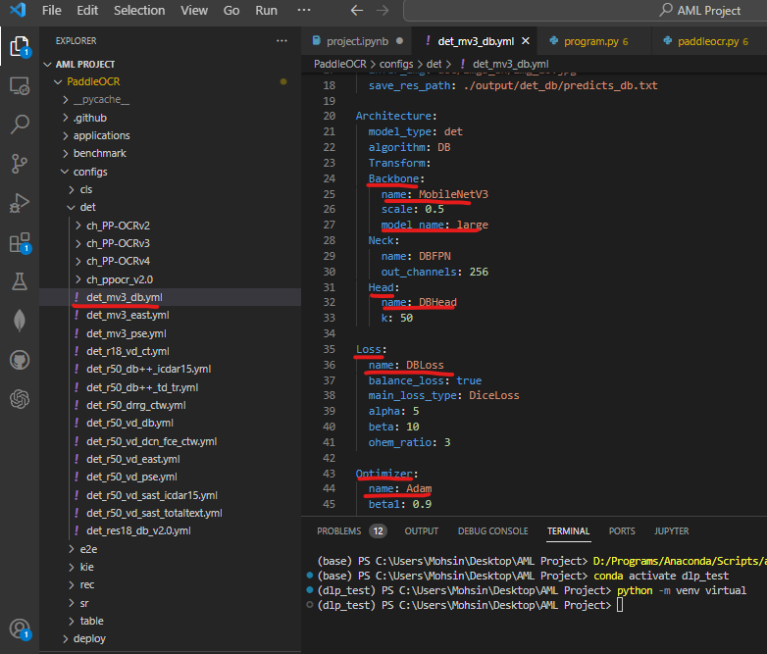
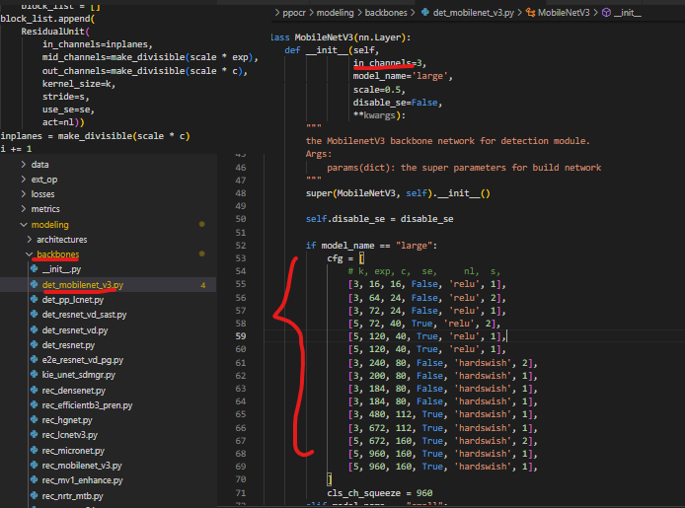
In Code

Slide 16
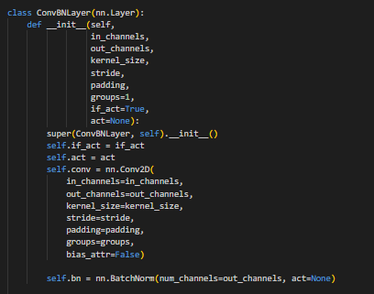
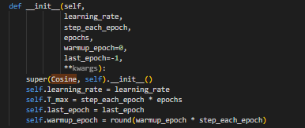
In Code

Slide 17
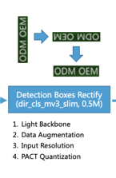
Direction Classification
The input resolution of a normalized image is increased, accuracy will also be improved.
PP-OCR, the height and width is set as 48 and 192, respectively, to improve the accuracy of the direction classifier

Slide 18
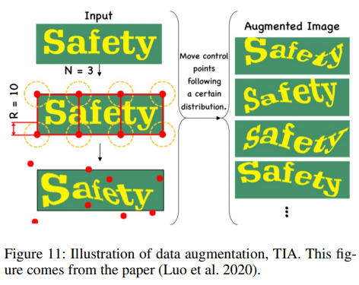
Data Augmentation
BDA: BDA also is useful for the direction classifier training. Besides BDA, some new data augmentation operations are proposed recently for improving the effect of image classification , for example, AutoAugment
But the experiments show that most of them don’t work for the direction classifier training except for RandAugment and RandErasing. RandAugment works best.

Slide 19
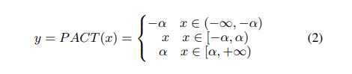
PACT Quantization
Quantization allows the neural network model to have lower latency, smaller volume and lower computational power consumption
Offline quantization refers to a fixed-point quantization method that uses methods such as KL divergence and moving average to determine quantization parameters and does not require retraining
Online quantization is to determine quantization parameters during the training process, which can provide less quantization loss than offline quantization mode
Using ordinary PACT quantization leads to a higher quantization loss. Therefore, we modify the formula of the activations preprocessing as follows to reduce the quantization loss.
the activation functions in MobileNetV3 are not only ReLU, but also hard swish

Slide 20
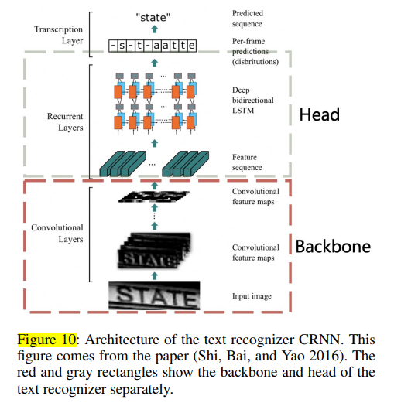
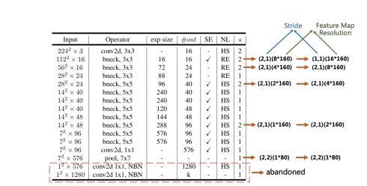
Text Recogntion
MobileNetV3 as the backbone of the text recognizer. MobileNetV3 small x0.5
L2 regularization (L2 decay) to avoid overfitting

Slide 21
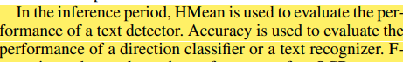
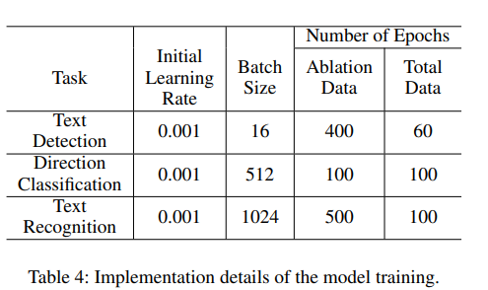
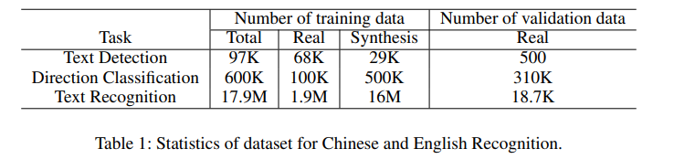
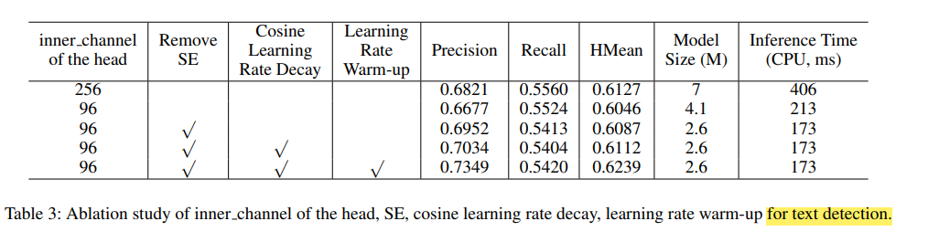
RESULTS

Slide 22
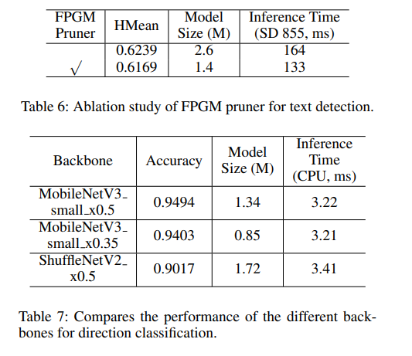
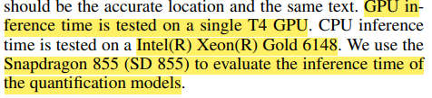
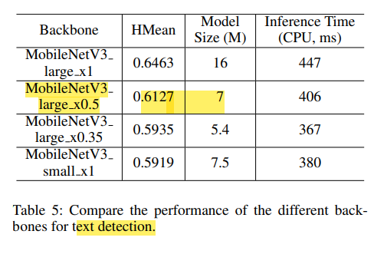
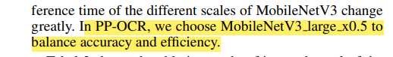
RESULTS

Slide 23
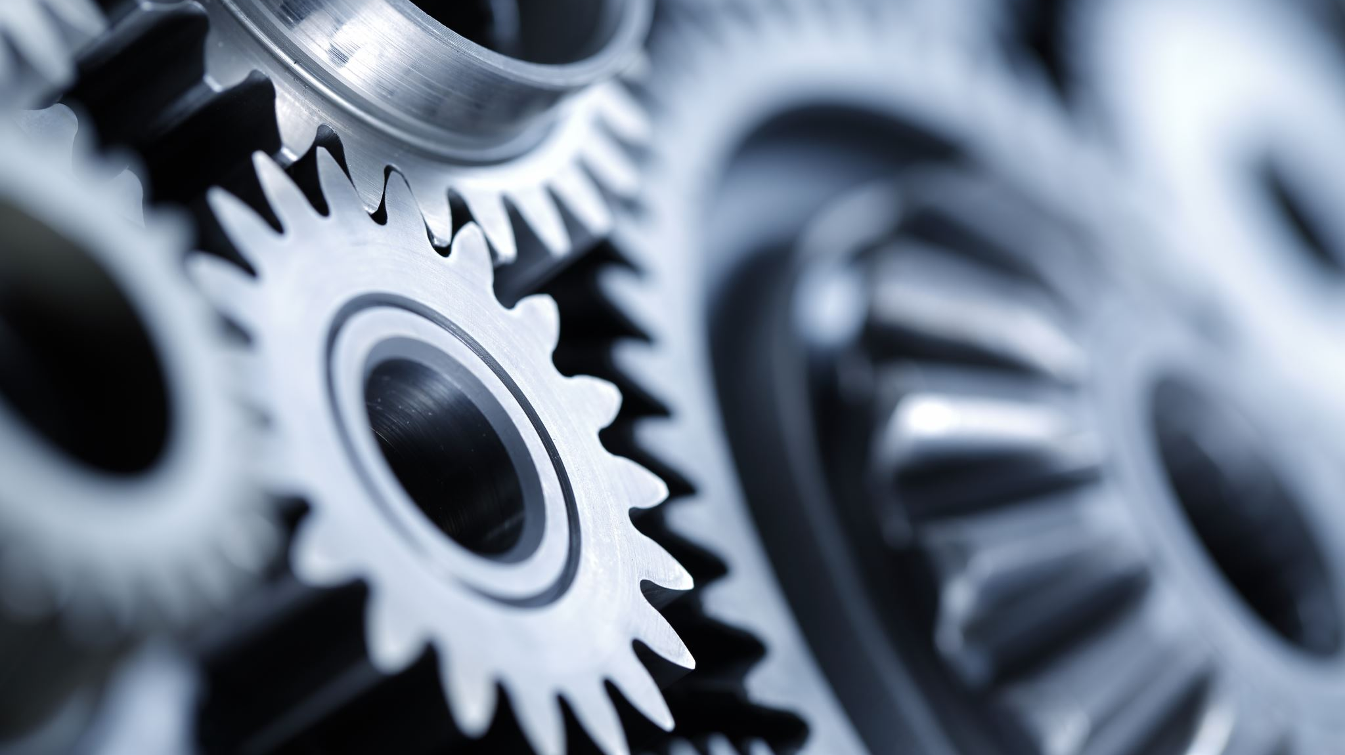
Training The Model

Slide 24
Training The Model
https://colab.research.google.com/drive/1uPvOprqYB4RKSKKynSuE50wMfZZQ1N6Z?authuser=2
Epochs | Evaluation/ Iter | Eval Precision | Eval Recall | Eval Hmean
2 | 50 | 0.09173 | 0.02455 | 0.03874
5 | 50/100 | CRASH | CRASH | CRASH
4 | 100 | 0.1695 | 0.1001 | 0.1259
Epochs | Evaluation / Iter | Eval Precision | Eval Recall | Eval Hmean
2 | 50 | 0.07321 | 0.01545 | 0.02654
5 | 5 | 0.2602 | 0.1561 | 0.1952
200 | 200 | 0.6224 | 0.5416 | 0.5801
Colab T4 GPU
Local Nvidia 1650Ti GPU

Slide 25
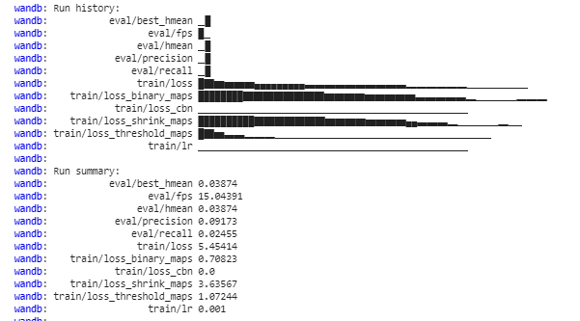
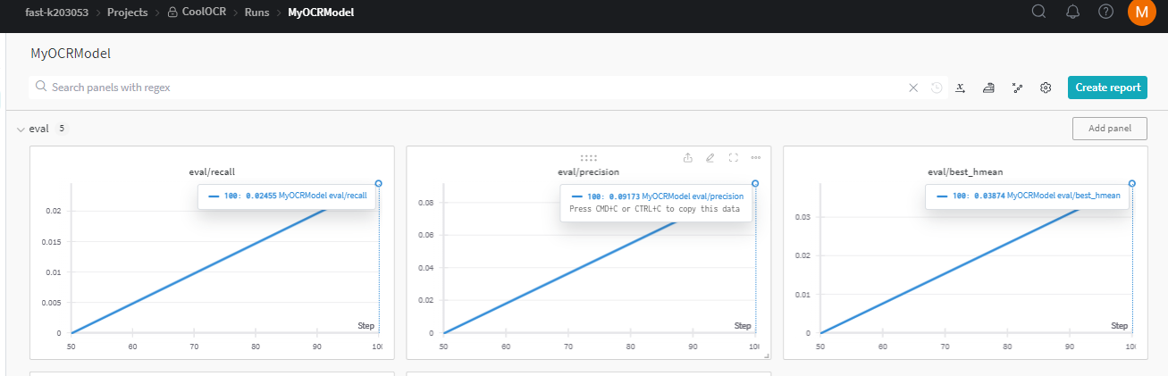
Results-Colab

Slide 26
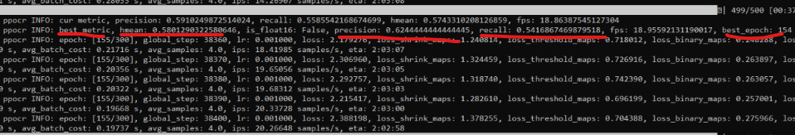
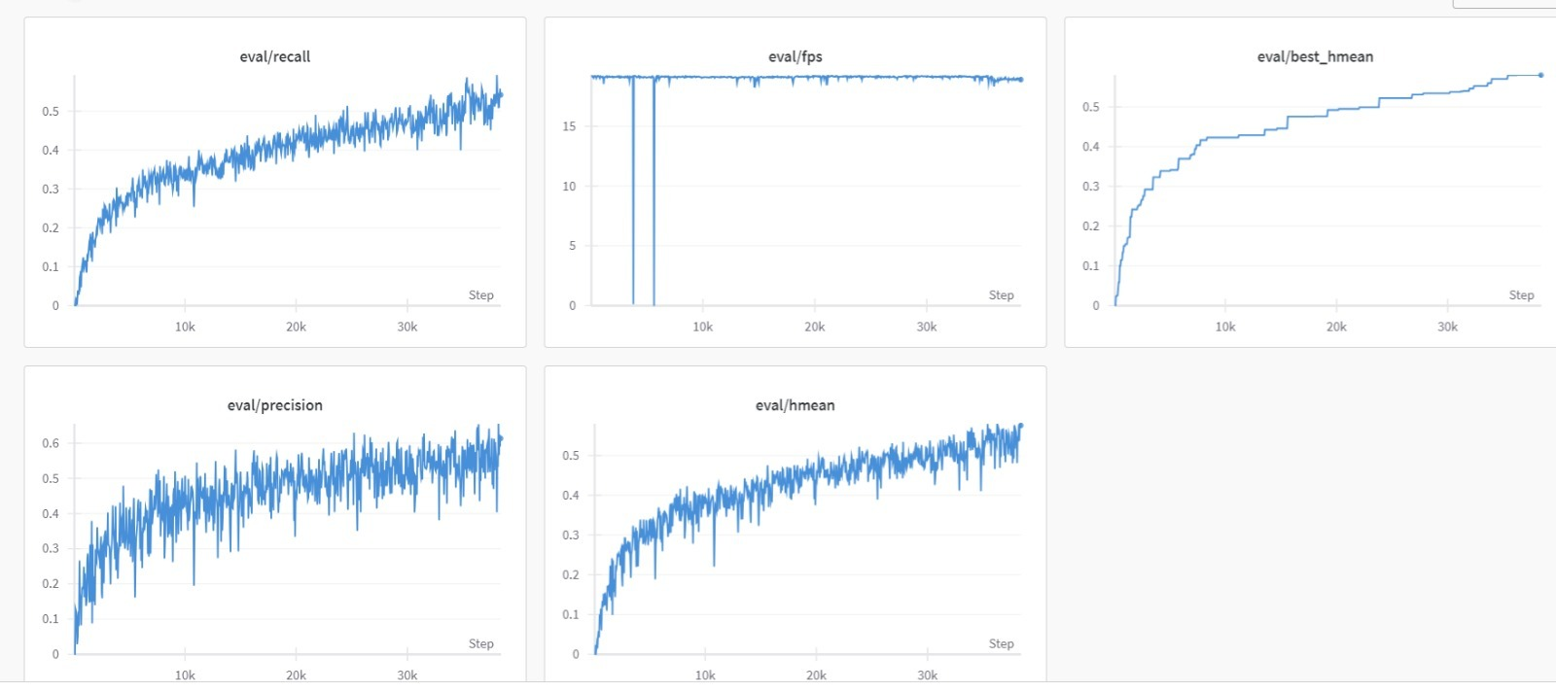
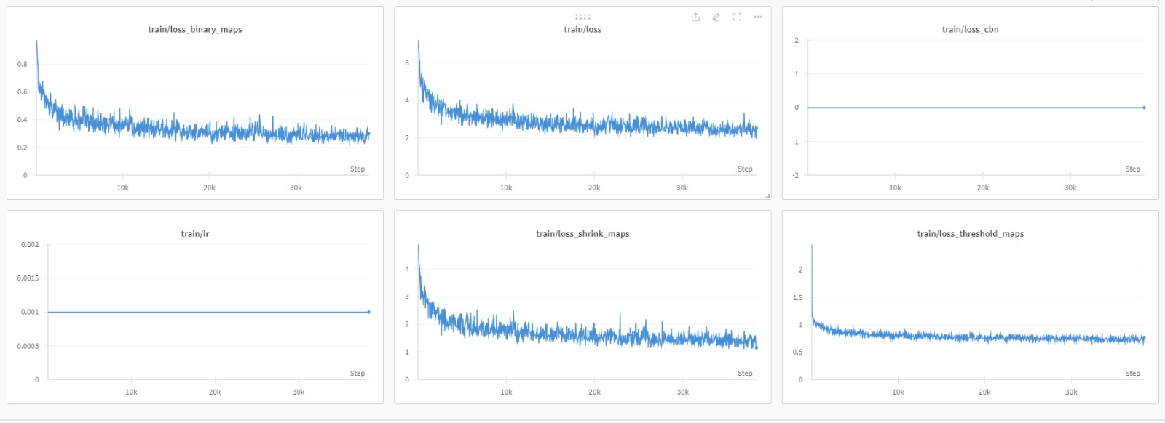
Results-Local 1650Ti

Slide 27
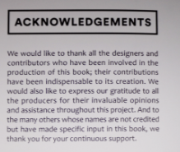
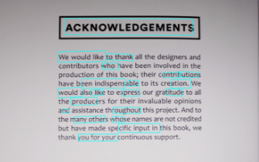
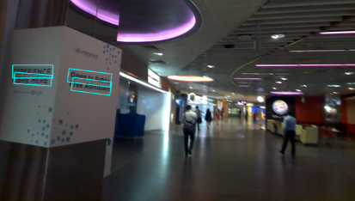
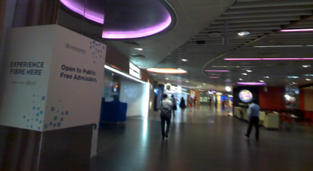
Results-Colab (0.1%)

Slide 28
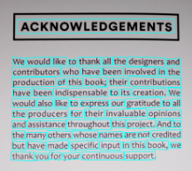
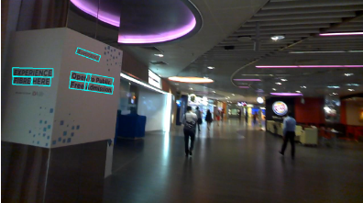
Results-Local (0.6%)

Slide 29

Inference Application

Slide 30
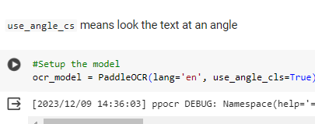
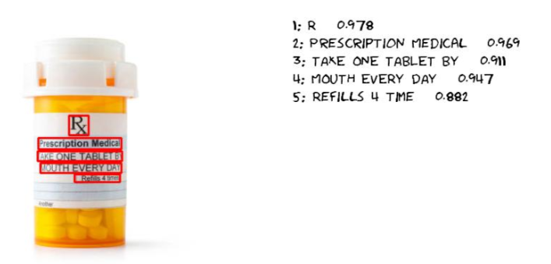
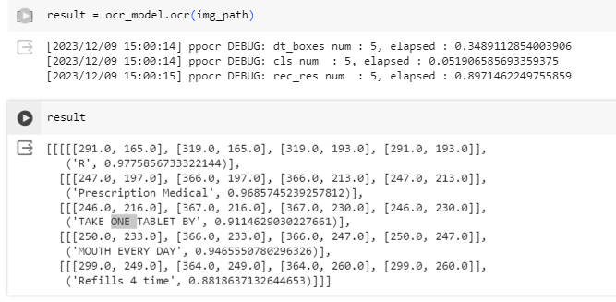
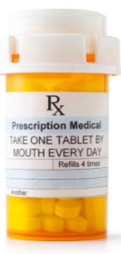
Inference
https://colab.research.google.com/drive/1TQxml68_nunberR0mkYMPohSIxcGWQlf?authuser=1#scrollTo=cSdKaLb7A7g2

Slide 31

Thank You
By Mohsin Ali Mirza k200353
If you have any questions please feel free to ask

